Slide 1

Smart Streetlight
Proof of Concept
Tucker Russ
Thor Cutler
Brandon Berry
Anthony Giordano
Group 3
03/26/16

Slide 2
Overview
Group 3
Tucker
Introduction
Solution
3D Printing Progress
XBee Configuration
XBee Frame Comprehension
Model Design
Battery Backup System
Circuit Design
Shark Tank Progress

Slide 3
Introduction
Group 3
Tucker
Fully working Smart Streetlight System Demo Model
Give exposure to new Smart Grid Technology
Build system using our design and code
Three complete Streetlights and a User Interface Device
Show advantages of implementing Streetlights on our Campus
Participate in Engineering Shark Tank

Slide 4
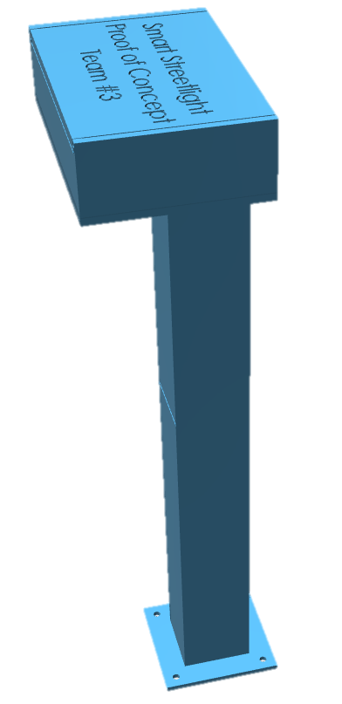



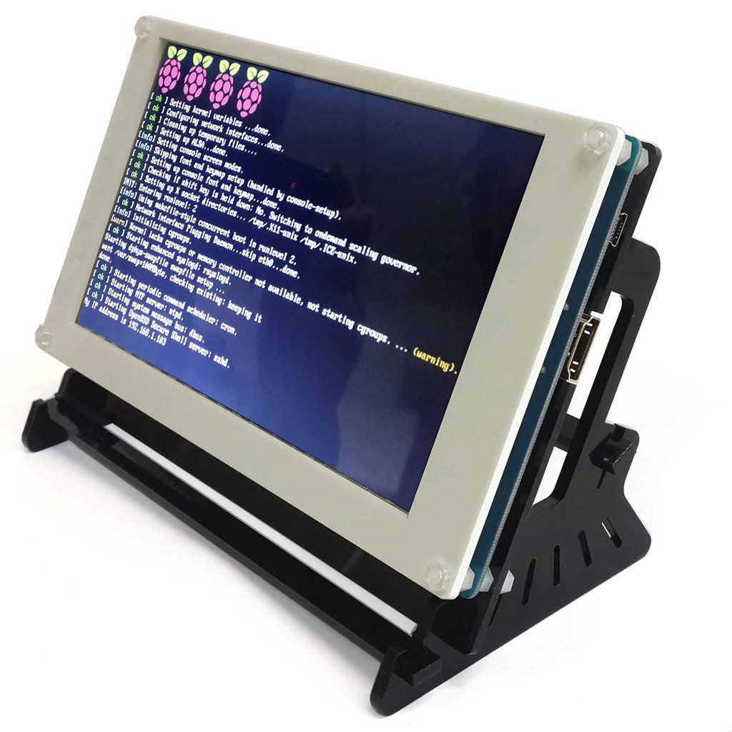
Smart Streetlight System Scenario
Group 3
Tucker
When a Streetlight, House, or Campus Building loses power
The utility company will be immediately notified of the outage and the location through the User Interface Device
User
Notes:
This allows them to not only know the exact time of the outage but also if other devices are effected (Ill talk more about that) and the exact location so they can pinpoint the problem which leads to less troubleshooting

Slide 5
Top-level Model Hardware Design
Group 3
Tucker
802.15.4 P2P protocol

Slide 6


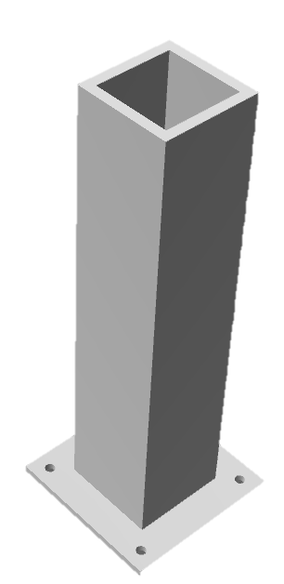
3D Printing Progress
Group 3
Tucker
Each Streetlight is printed in 3 parts in order to make up the entire dimensions of the Streetlight
3D Printer MAX printing dimensions: 130 x 96 x 139 (mm)
Part 1: Part 2: Part 3:
85 x 55 x 5 (mm) 87 x 57 x 127 (mm) 20 x 20 x 127 (mm)

Slide 7
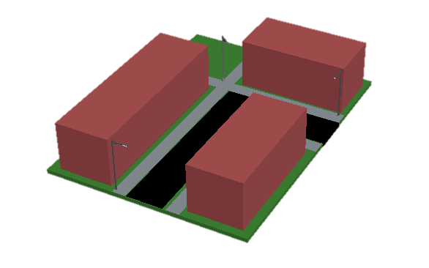
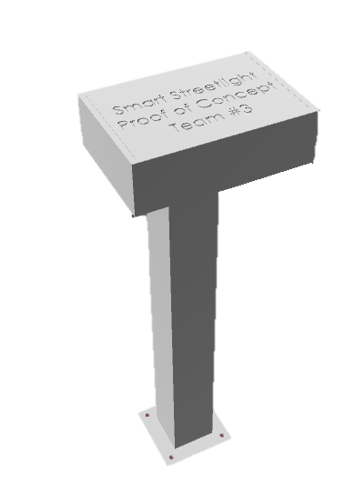
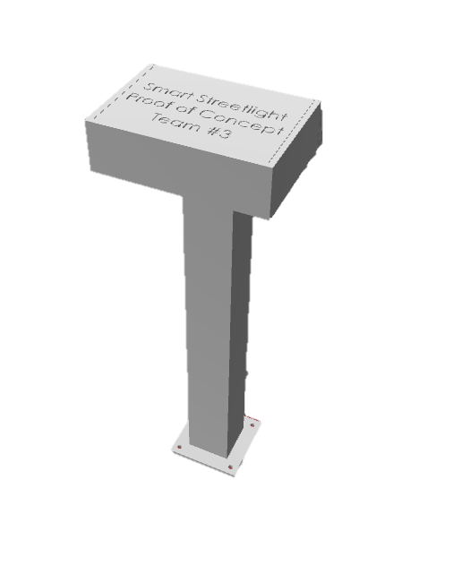
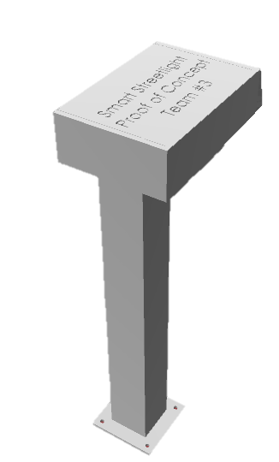
Scaled Model on Cart
Group 3
Tucker

Slide 8
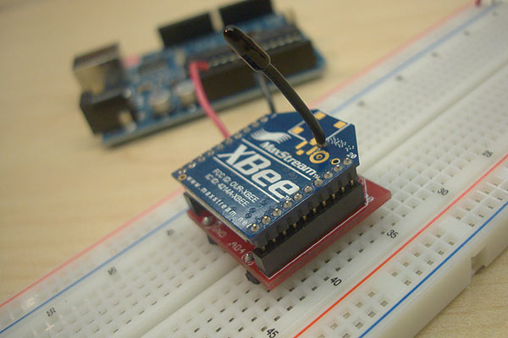
XBee Series 1
Group 3
Thor
2.4GHZ using IEEE 802.15.4
P2P and multi-point Mesh Network
3.3V, 50mA Input
300ft max outdoor range
1mW Output
6 10-bit ADC input pins
65536 Channels
Local or over-air configuration

Slide 9
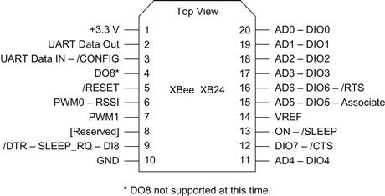
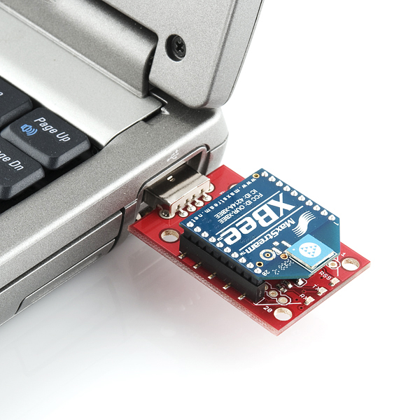
Configuration
Group 3
Thor
XBee devices are configured using X-CTU, a free multi-platform application by Digi
X-CTU allows each XBee device to be flashed with personal settings, such as using a certain pin as a digital input.

Slide 10
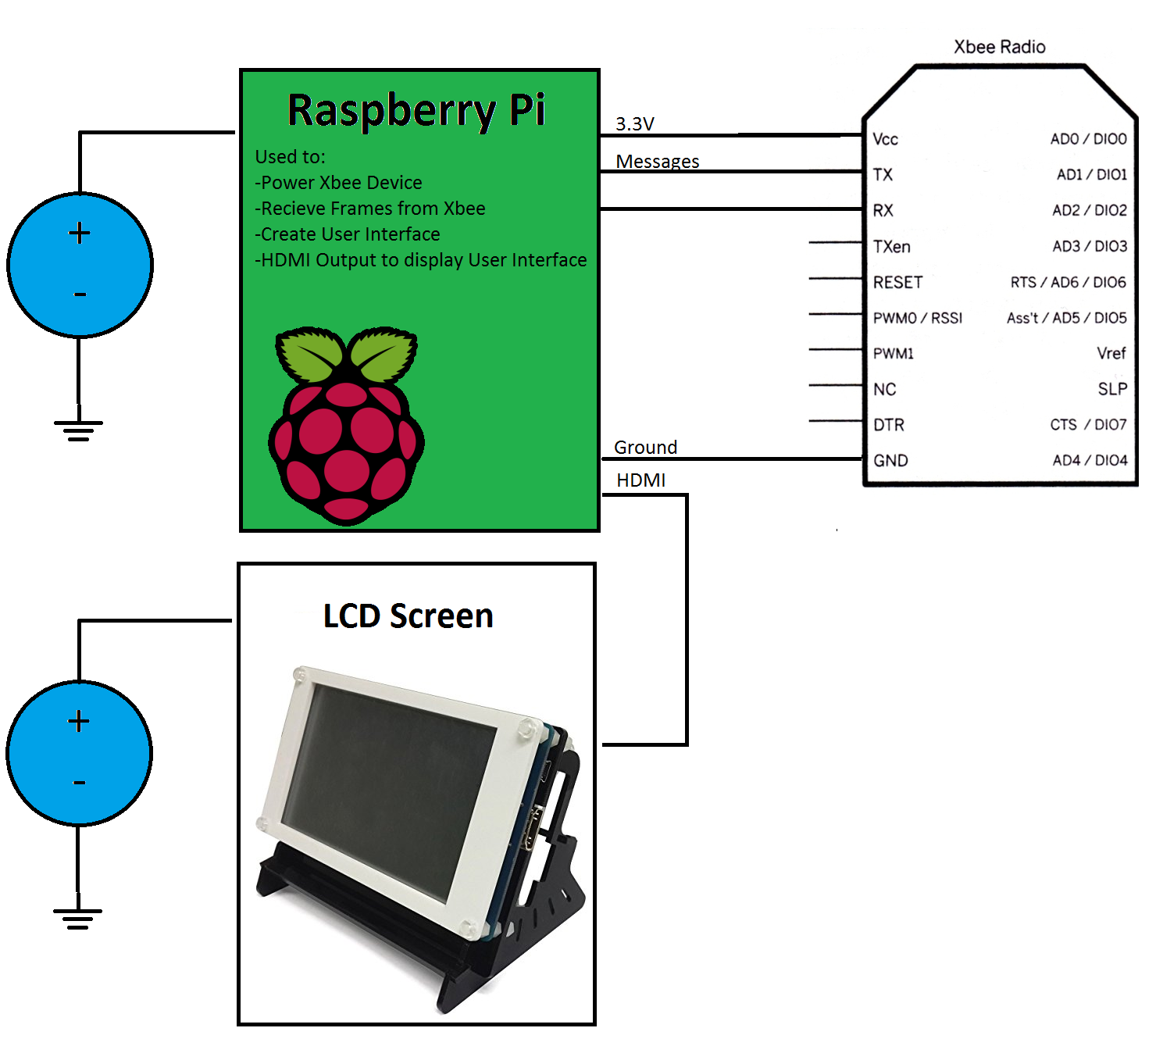
User Interface XBee Device Design
Group 3
Thor

Slide 11

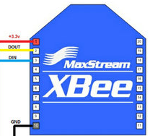
User Interface XBee Device Properties
Group 3
Tucker
The Raspberry Pi will be connected to its own XBee device that is set up to receive data packets (frames) from the Xbee devices attached to monitored devices
The Raspberry Pi will use the data from the frames to determine the status of each monitored device
The status of each monitored device will be viewable on the LCD screen,

Slide 12
User Interface Software Solution
Group 3
Tucker
2 Step Process
  Step 1: Information Recording
    Device would be left in recording mode overnight to determine the status of each streetlight in the network and record the data
    After a set amount of time the device would stop recording (Normally in the morning when streetlights are turned off)
  Step 2: Visual Representation of Data
    Currently being developed
    Opens text file created by Step 1 and displays the status of streetlights that need fixing

Slide 13
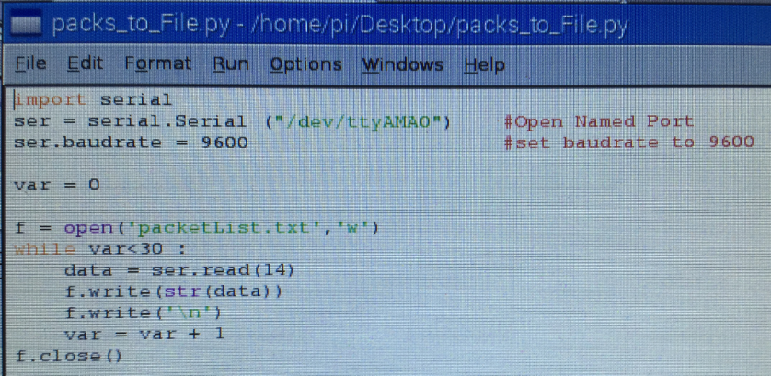
User Interface Step 1 Code
Group 3
Tucker

Slide 14
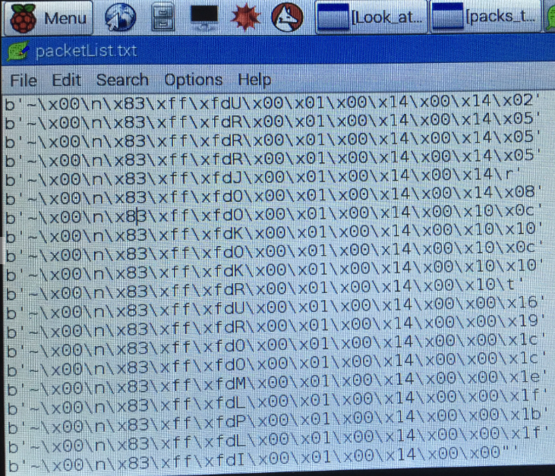
User Interface Step 1 Output
Group 3
Tucker

Slide 15
Power Layout of Model
Group 3
Brandon
Smart Meter
w/XBee
LED
120V
5V DC
5V
Streetlight 1
5V DC
5V
Streetlight 2
120 V
5V DC
5V
User Interface
5V DC
5V
Streetlight 3
120 V

Slide 16
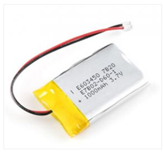
Why is a backup battery needed?
Group 3
Brandon
If the power supplied to the streetlight fails, the backup battery will provide enough power to allow the XBee to still transmit for 6+ hours for the model
The battery capacity would be scaled up with a full size design
This will allow for the ability to notify the user interface when the power to a streetlight has gone out
Once the system regains outside power, the battery will begin to charge back to its full capacity

Slide 17
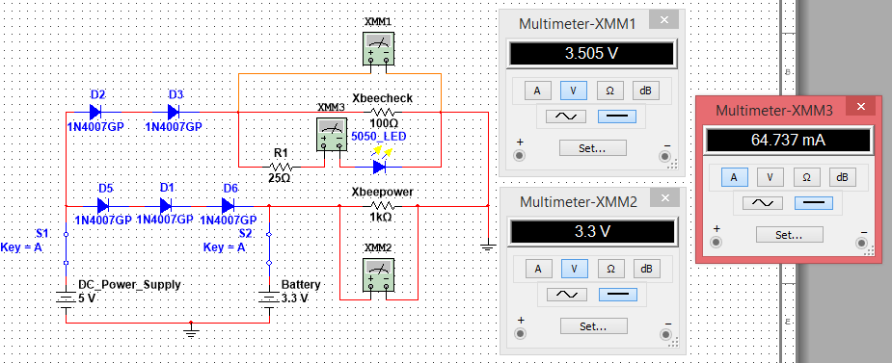
Original Node Power Circuit for XBee & LEDs
Group 3
Brandon

Slide 18
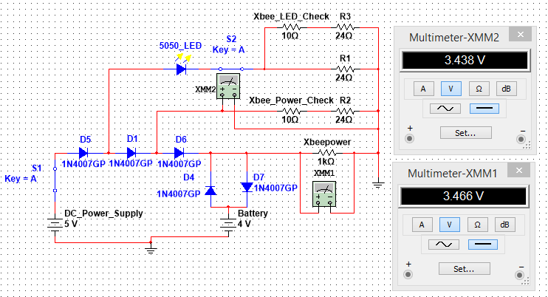
Updated Node Circuit While DC Power is Connected
Group 3
Brandon

Slide 19
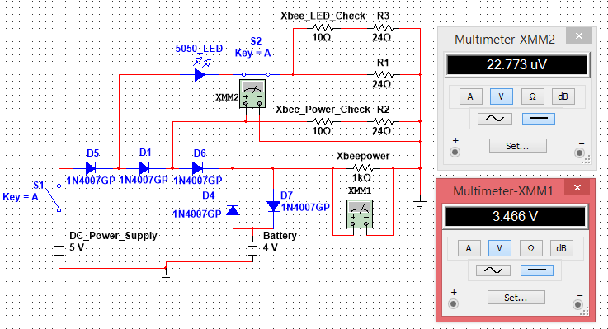
Updated Node Circuit While DC Power is Disconnected
Group 3
Brandon

Slide 20
While DC Power is Disconnected
Group 3
Brandon
Diodes are used to prevent the backflow of current when the DC power supply goes down
This allows the XBeeCheck to see that the DC power supply has stopped working while the XBee itself still receives power
A second check for when the LED goes out has been added to the circuit

Slide 21
XBee Check Readings
Group 3
Brandon
The voltage required to cause a “high” or “low” reading on the XBee:
Low < 0.9V
High > 0.9V
Each XBee check will be supplied over 0.9 volts to insure a high reading when needed
When the main power is lost or the LED goes out, the XBee checks will receive an insignificant voltage resulting in a low reading

Slide 22
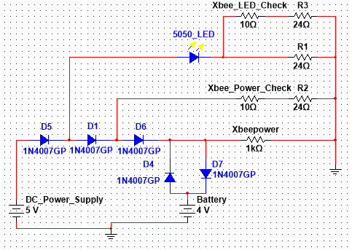
Actual Schematic for each Streetlight Node
Group 3
Brandon

Slide 23
Supplies List for each Streetlight Node
Group 3
Brandon
1 XBee
5 Rectifier diodes
1 4V Lithium-ion battery
3 24Ω Resistors
20 Gauge Wire
2 Toggle switches (for model purposes only)

Slide 24

Shark Tank
Group 3
Anthony

Slide 25

Target Market
Group 3
Anthony
Established lighting manufacturers
Utility companies

Slide 26
Potential Consumers
Group 3
Anthony
Who
Why
College campuses
  -Walkway lights
Neighborhood associations
  -Street lights
Recreational sports complexes
  -Field lights
Airports
  -Runway lights
Efficient lighting
Safety (well lit walkways)
Fast response to outages

Slide 27

Material Cost
Group 3
Anthony
User Interface
Individual Device
Raspberry Pi 2 - $35
Python software - $0
SSL software code - $0
XBee Pro - $40
Circuit board - $4
Wires - $2
Lithium Ion Battery - $20
Voltage Controller - $2

Slide 28


Competition
Group 3
Anthony
General Electric’s LightGrid
Uses wireless nodes to relay information obtained from an individual streetlight
Requires internet connection to communicate lighting performance
Contains GPS chips to locate the exact location of each light

Slide 29
Competitors Vs. SSL
Group 3
Anthony
General Electric’s LightGrid
Smart Streetlights
Multiple wireless features to monitor and control lights
Requires Internet Access
Up to$400 per light
Addition software license costs
Single wireless feature to check status of lights
No internet access required
Approximately $68.00 per light
One time purchase (no contract)

Slide 30

Competitive Advantage
Group 3
Anthony
Simple solution for monitoring the status of each individual streetlight
Cost efficient alternative to replacing full streetlight
Does not require internet connection

Slide 31
Selling Points
Group 3
Anthony
Provides quick response to streetlight outages
Increases safety providing reliable lighting
Inexpensive compared to competitors

Slide 32
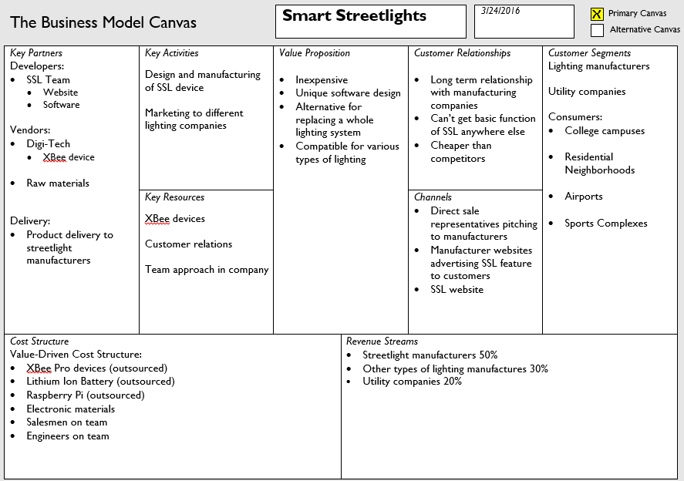
Group 3
Anthony

Slide 33
Questions?
Group 3

